Slide 1

손동작 분류 경진대회
김다현, 윤태승, 이보원

Slide 2
TITLE
EDA
Ensemble
Deep Learning

Slide 3
EDA
Exploratory Data Analysis

Slide 4
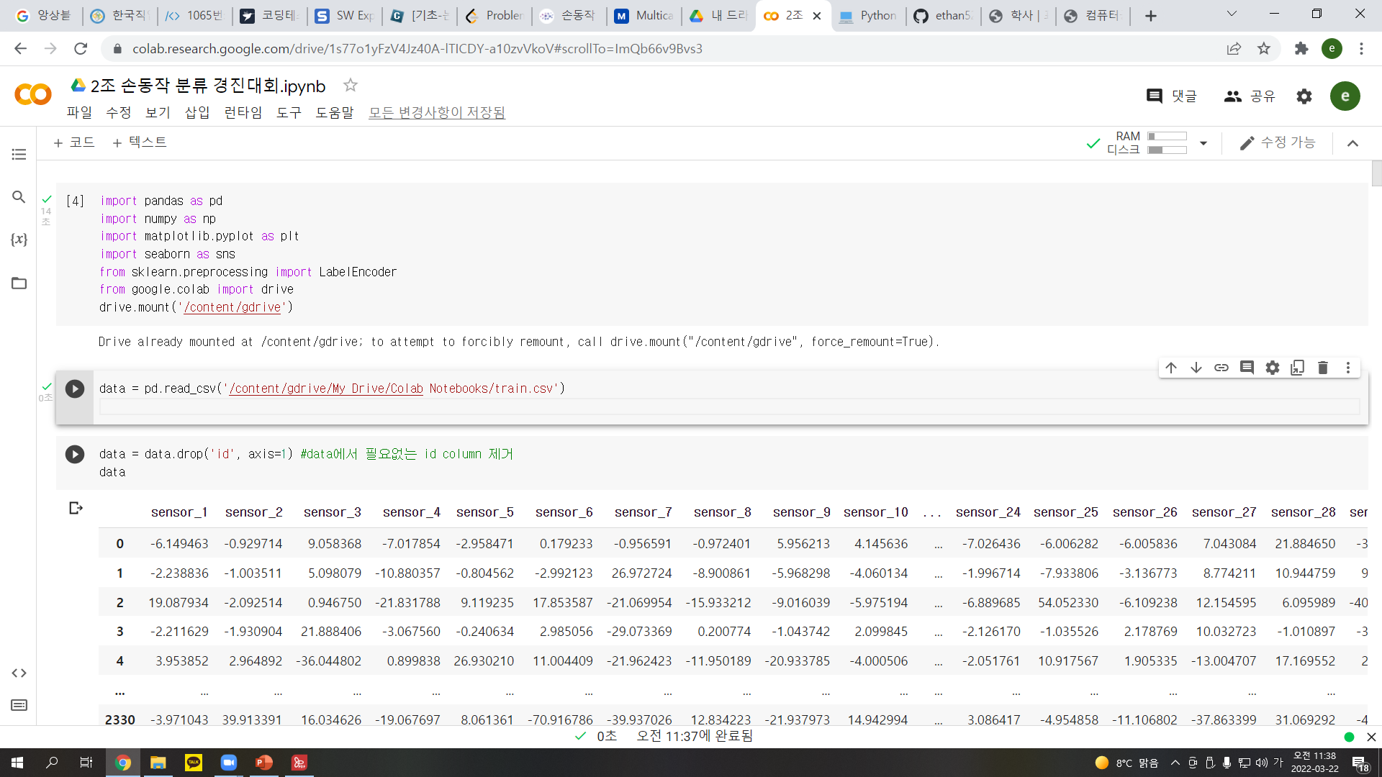
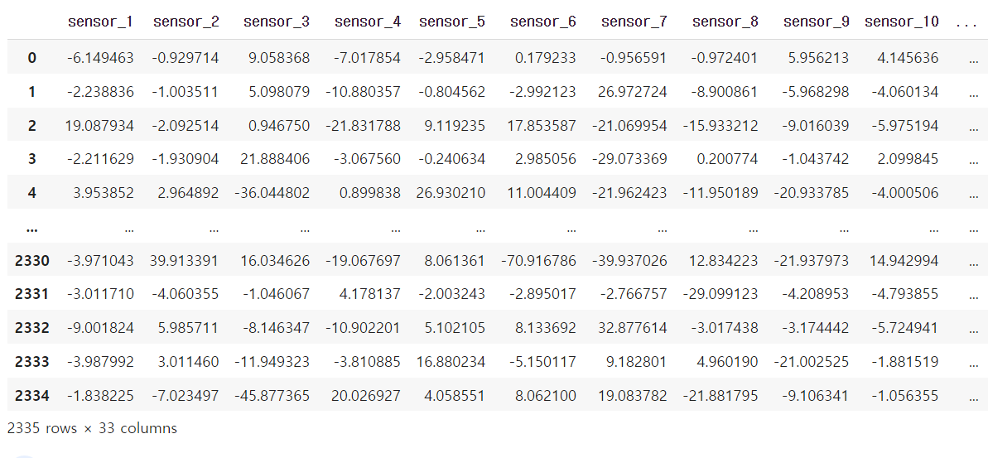
EDA

Slide 5
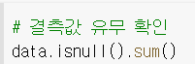
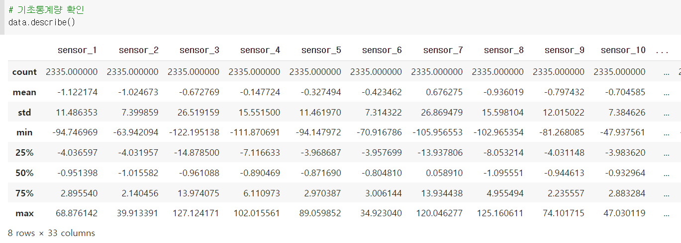
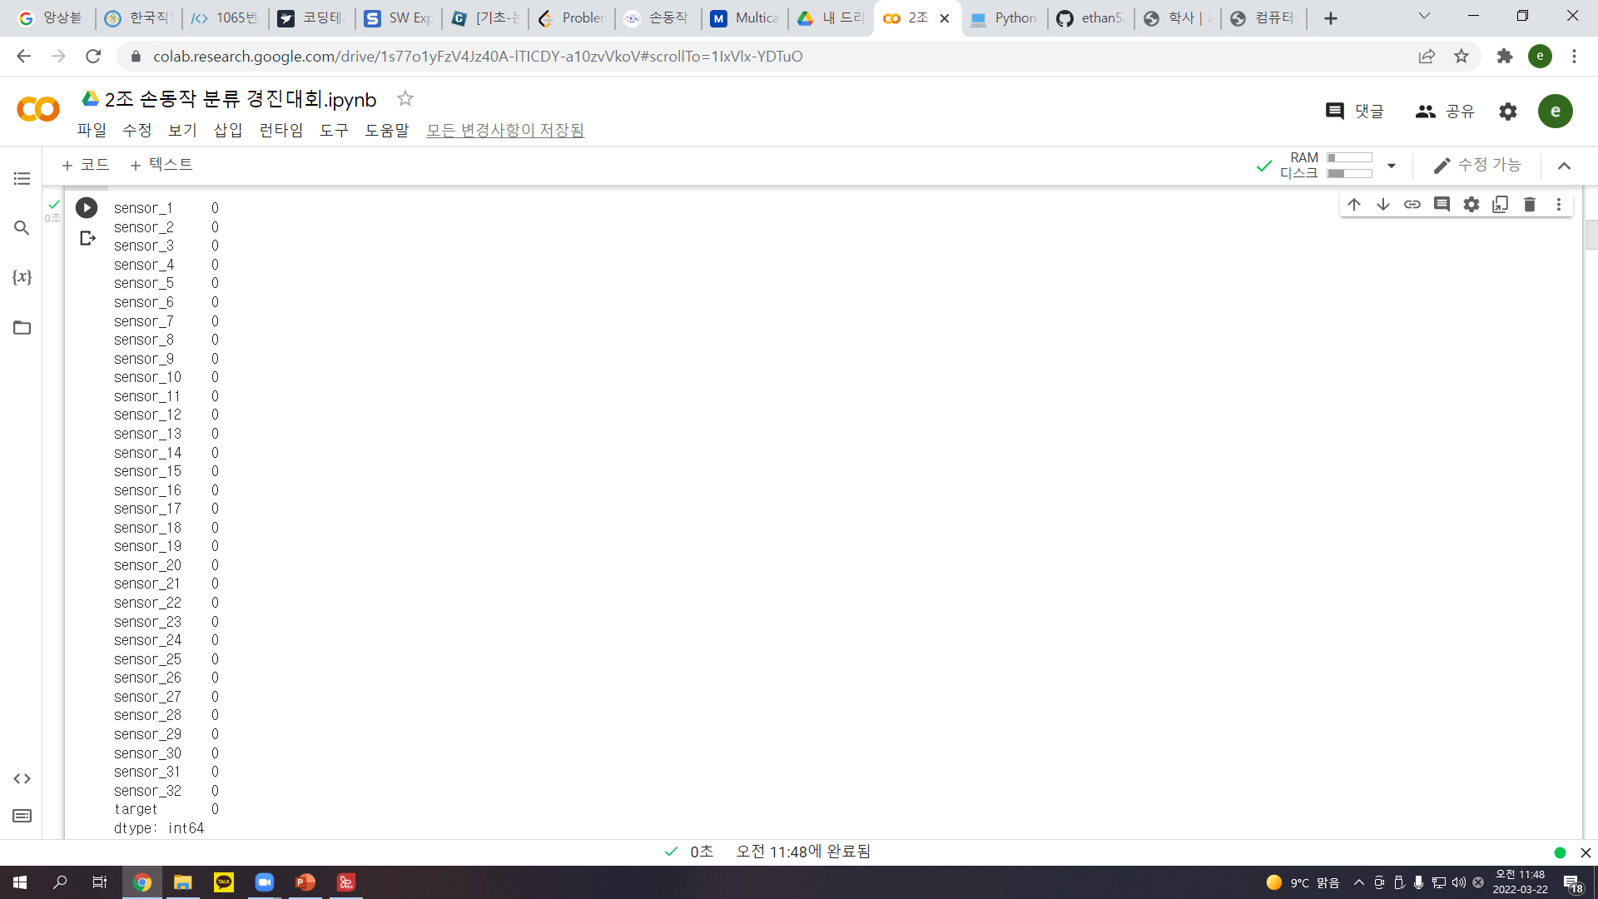
EDA

Slide 6
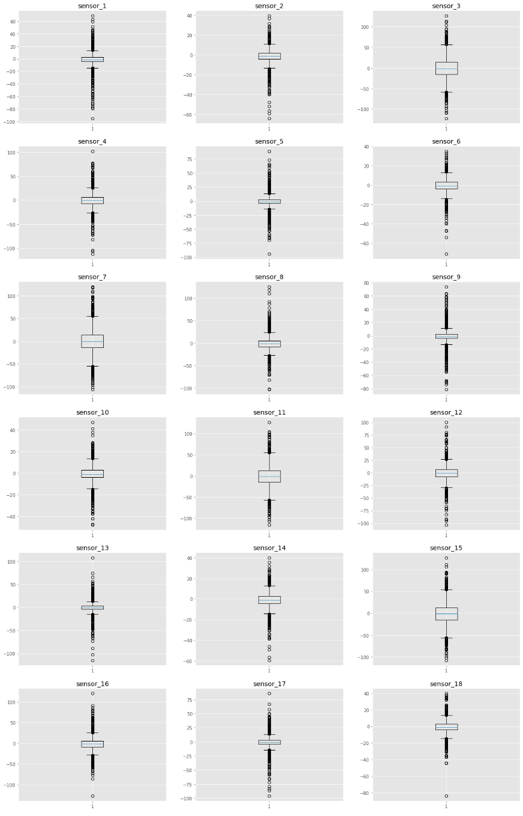
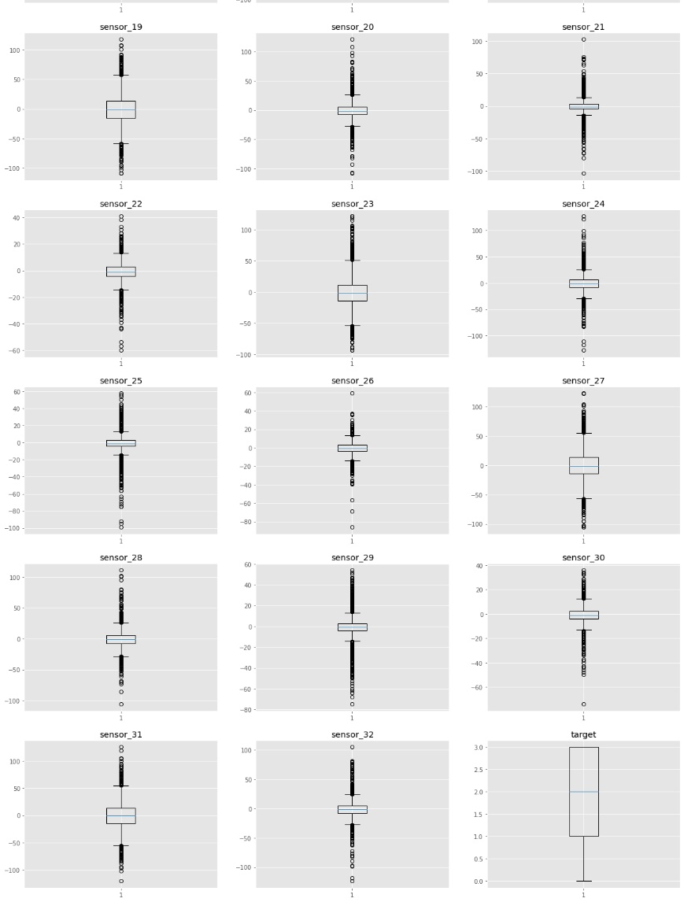
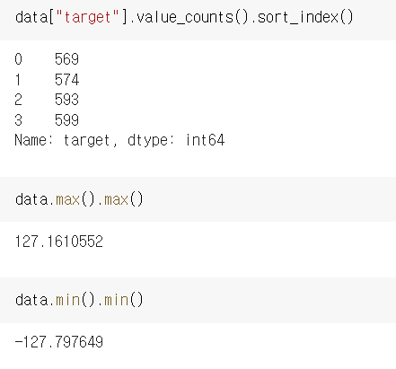
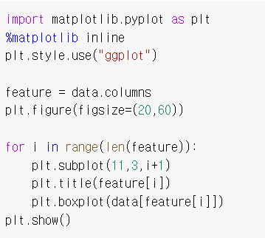
EDA

Slide 7
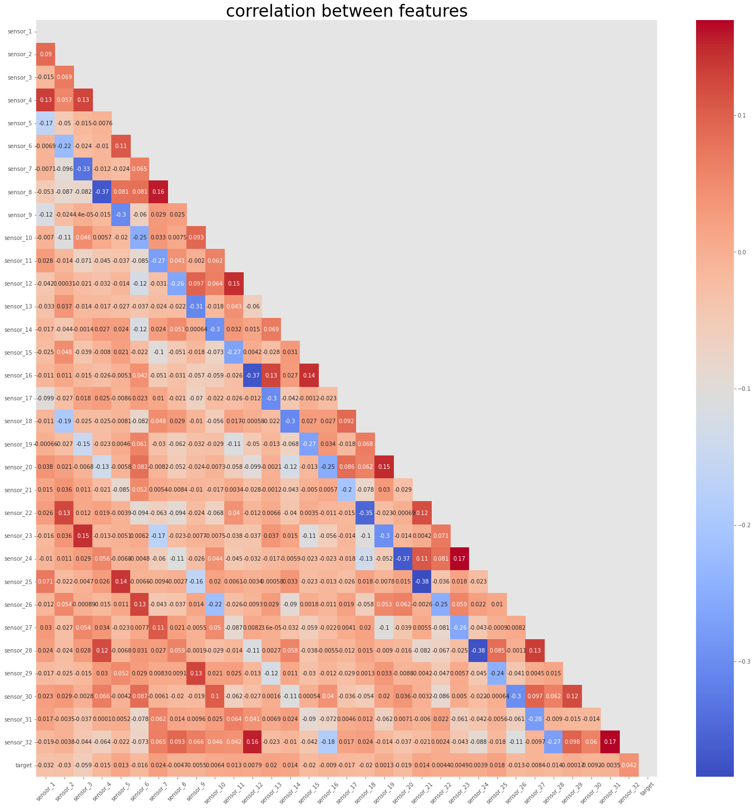
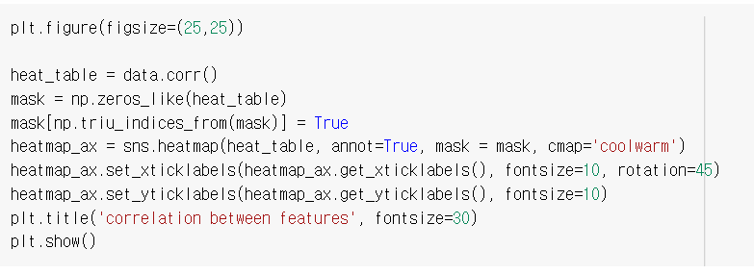
EDA

Slide 8
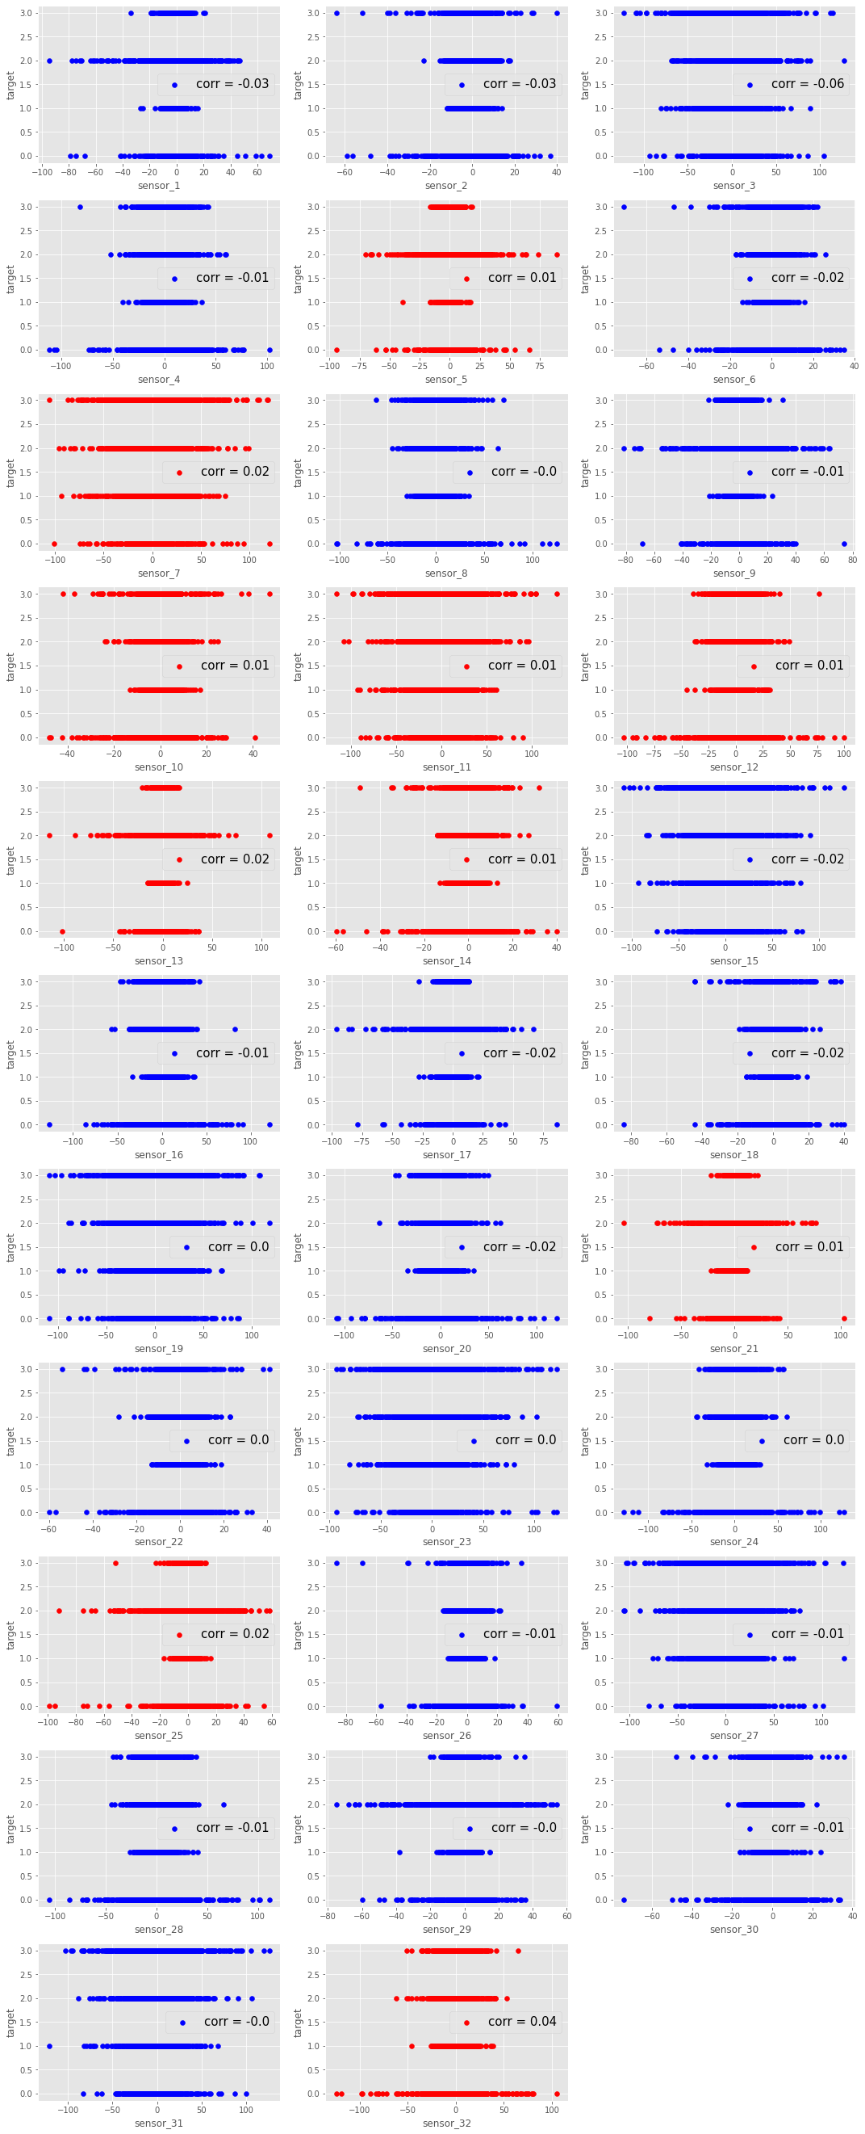
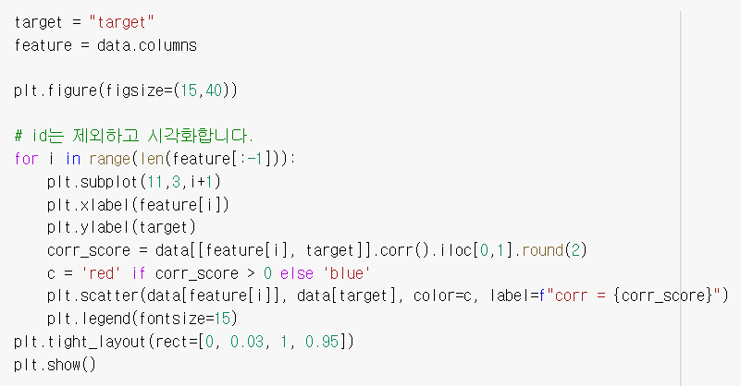
EDA

Slide 9
Ensemble

Slide 10
Ensemble

Slide 11
Ensemble

Slide 12
Ensemble

Slide 13
Ensemble

Slide 14
Ensemble

Slide 15
Ensemble

Slide 16
Ensemble

Slide 17
Ensemble

Slide 18
Ensemble

Slide 19
Ensemble

Slide 20
Deep Learning

Slide 21
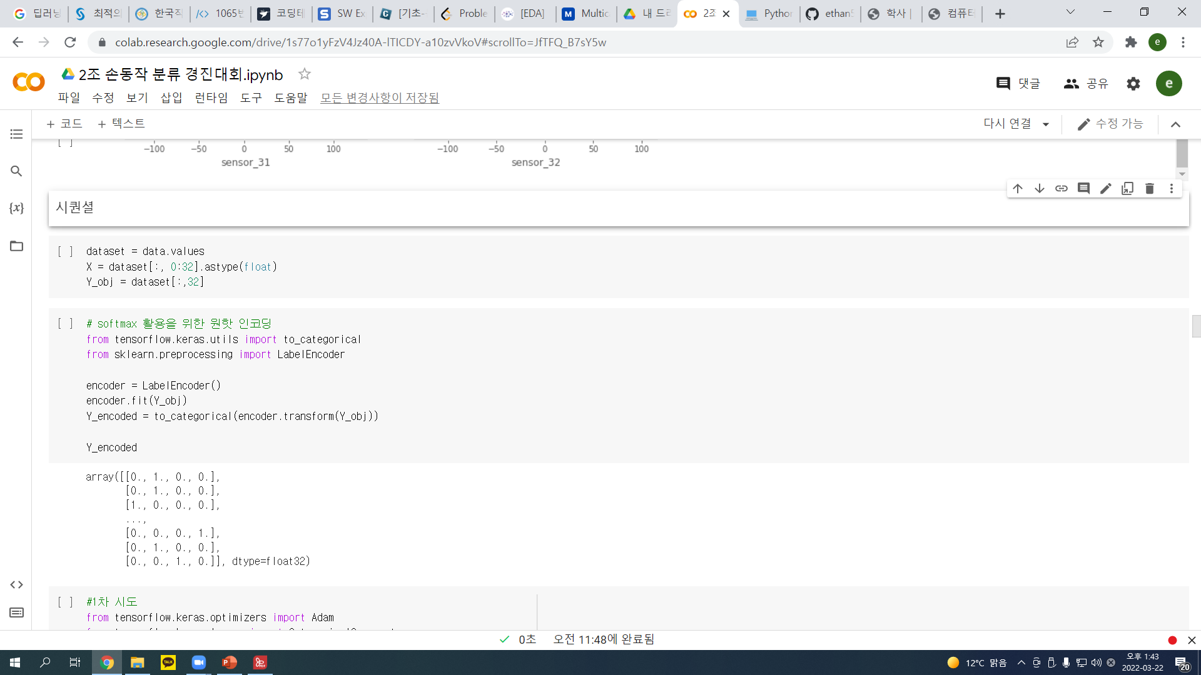
Deep Learning

Slide 22
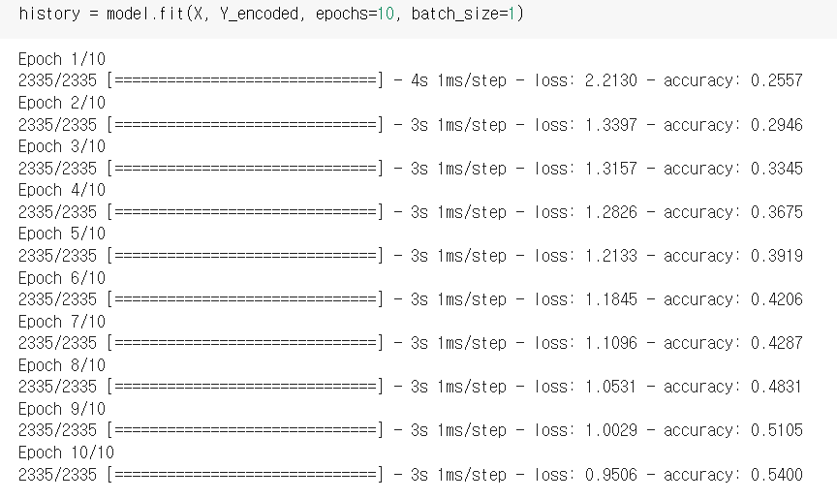
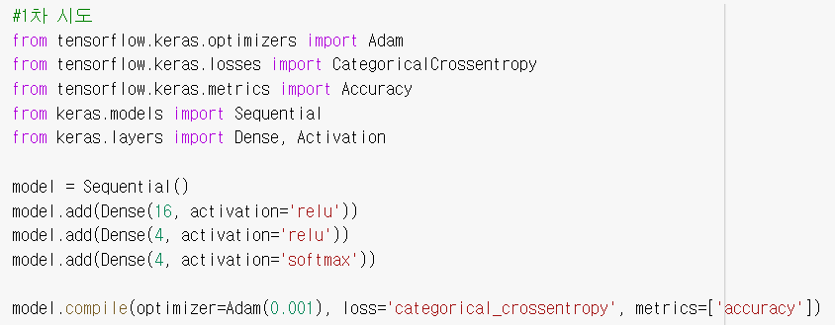
Deep Learning

Slide 23
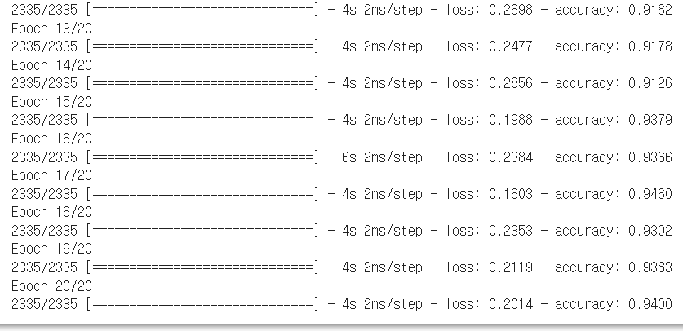
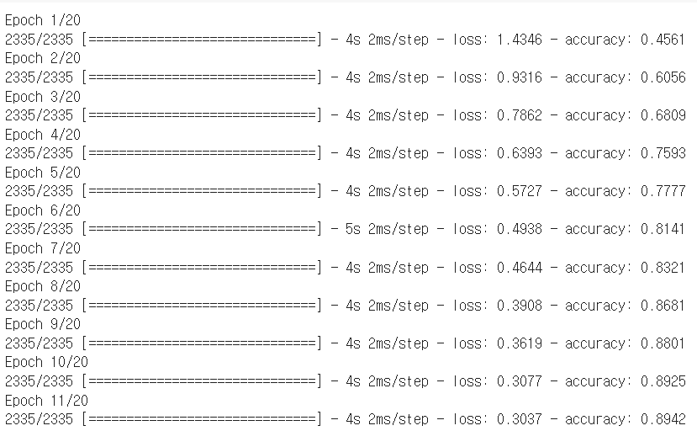
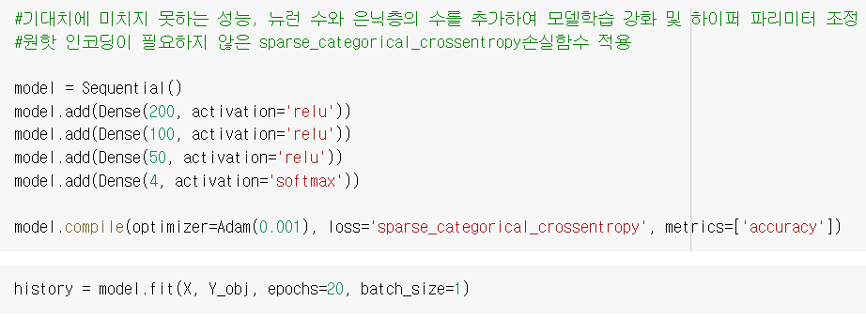
Deep Learning

Slide 24
Deep Learning

Slide 25
Deep Learning

Slide 26
Deep Learning

Slide 27
Deep Learning

Slide 28
Deep Learning

Slide 29
Deep Learning

Slide 30
Deep Learning

Slide 31
감사합니다

